Slide 1
MG REVIEW
Office Visit- June/July, 2000
Report Issued- July ___, 2000
Confidential

Slide 2
MG Review
Review Highlights
Project Objective:
We performed an on-site review of processes, procedures and controls that support the MGL and MGMCC trading activities within the London office. Our procedures included interviews with key commercial and accounting personnel. We also performed a test of commodity transactions from deal execution through to settlement entries.
Team Members: Office Personnel Interviewed:
Brent Price David Tregar - Finance Director
Tim Poullain-Patterson Kevin Rhodes - Director MGL
Nic Swingler - AA Howard Carter - Director MG MCC
Hassaan Majid - AA John Lunzer - Traffic Manager
Socrates Paschalis - AA Alan Jameson- MGMCC Credit Manager
Peter McKee - AA Jon Barrett- MGL Risk Compliance Officer
Ati Othman - AA

Slide 3
MG Review
Observations
EFFECTIVE CONTROLS
Single system (AS-400) utilized for deal processing from deal entry to General Ledger and all deal updates are captured within that system
Contracts are reviewed and signed by both the trader who executed the deal and the Head Trader before being sent to counterparties
Counterparty Credit limits available to traders on-line
All payments must be authorized by two MG directors before Treasury will process a payment
Deals are reconciled twice per day between the AS-400, trade blotter and deal tickets; _% of MGL trades automatically matched and cleared through the LME/LCH

Slide 4
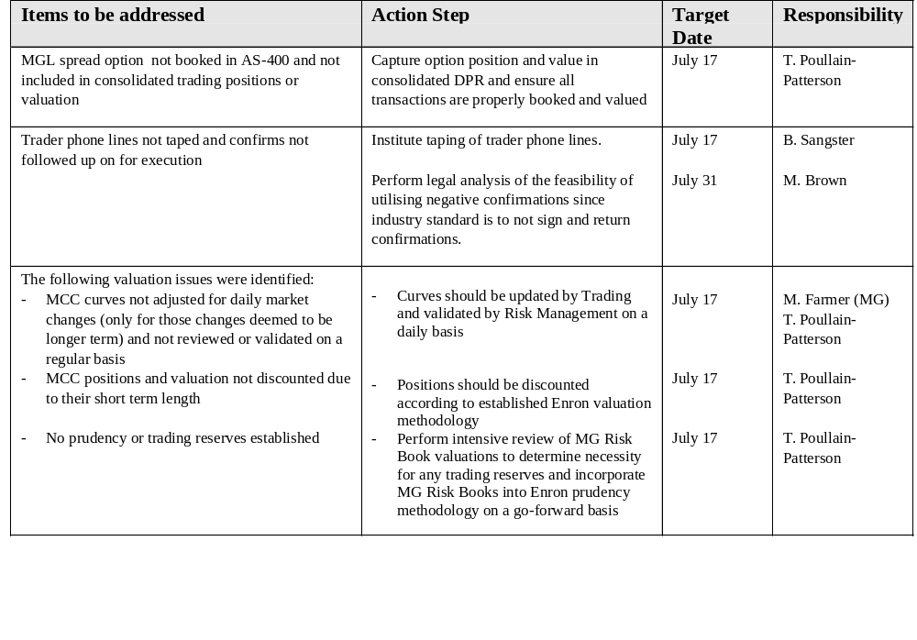
MG Review
Observations

Slide 5
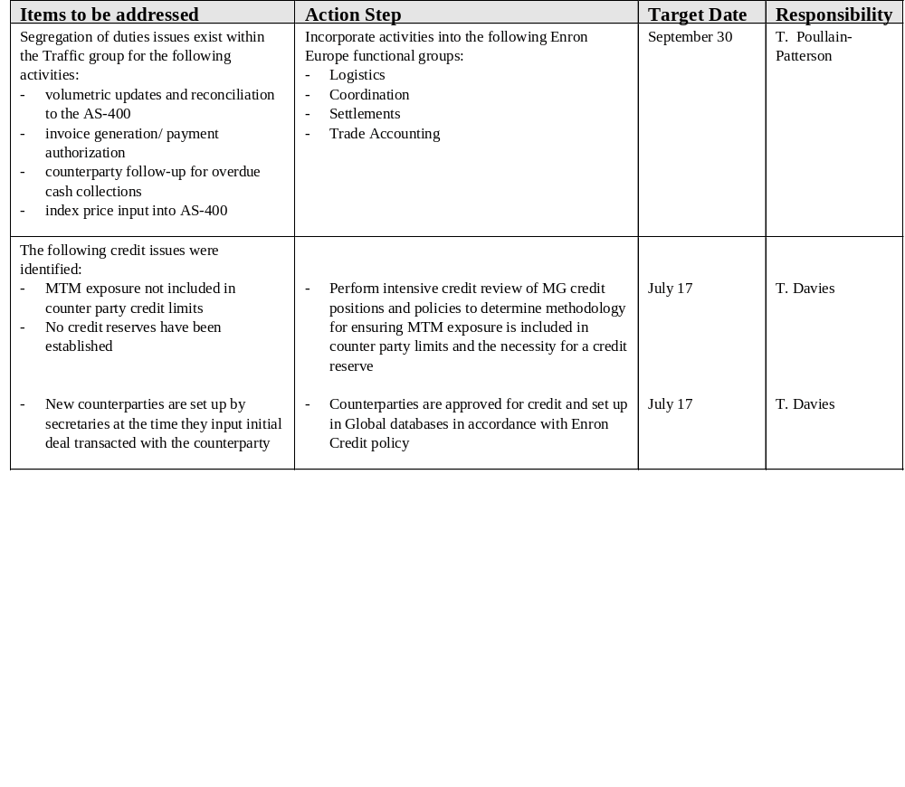
MG Review
Observations

Slide 6
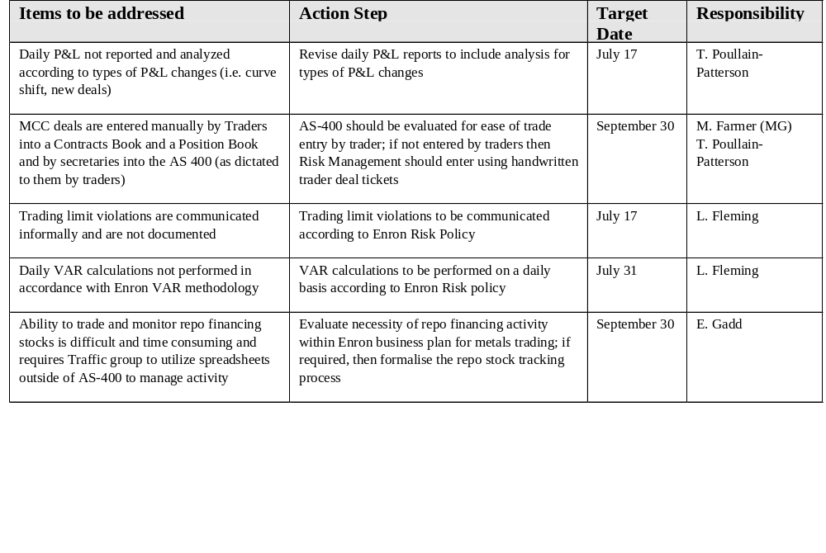
MG Review
Observations

Slide 7
MG Review
Observations
AREAS FOR FURTHER REVIEW
Regulatory issues related to the CDL risk book (MG Far East Ltd)
Cash forecasting
Unpriced deal valuation
Master Agreement status
IT security and controls
Wolff integration

Slide 8
MG Review
Attributes
MG MCC- Key attributes tested
Deal Capture
  Authorized trader
  Deal ticket sign-off ( AS-400 printout)
  Deal details agree to Draft Faxed Confirmation
Documentation
  Confirmation creation date
  Time taken to create contract since trade date
  Authorized signatory
  Counterparty approval date
  Contract agrees to AS-400 and Draft Faxed Confirmation
  Letter of Credit
Logistics: Physical Deals only
  Bill of Lading agrees Invoice
  Warehouse release document agrees to Invoice
  Consignment stock release agrees to Invoice
Settlement/ Accounting process
  Invoice quantity agrees AS-400
  Counterparty Invoice agrees to Payment Instruction Sheet (purchases only)
  Invoice agrees to deal data per Confirmation
  Disbursements properly approved
  AR/AP entry
  Physical evidence of cash

